Slide 1

VIETNAM-KOREA UNIVERSITY OF INFORMATION AND COMMUNICATION TECHNOLOGY
Fundamental project 01
Topic: Building a Bearbrick online store website
Instructor: Vo Ngoc Dat
Students: Le Thi Ngoc Diep 22IT.B050
Huynh Ngoc Dieu Hue 22IT.B088

Slide 2



An overview of the topic
1
The goal of the website
The main content
2
Product demo
3
Conclusion and development direction
4

Slide 3

01
An overview of the topic

Slide 4


The reason for choosing the topic:
The desire to bring Bearbrick closer to everyone through the website
Help optimize costs, improve business efficiency, and easily manage the store
Promote the store's image, build its brand, and reputation
"Building a Bearbrick online store" is essential to create convenient conditions for consumers to easily access products and services anytime, anywhere.

Slide 5
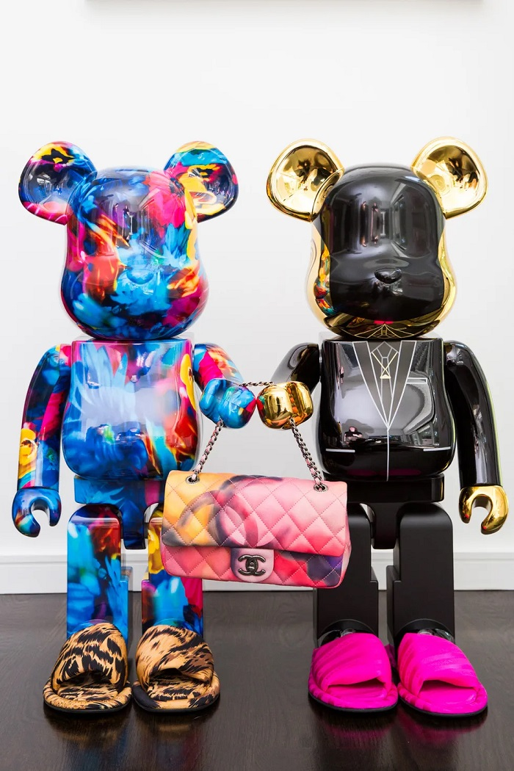
Description:
Bearbrick is a famous toy and accessory brand from Japan. The main product of Bearbrick is a small, compact, and customizable bear-shaped toy that can change its size from 50% to 1000%. It is manufactured by the company Medicom Toy Inc.

Slide 6
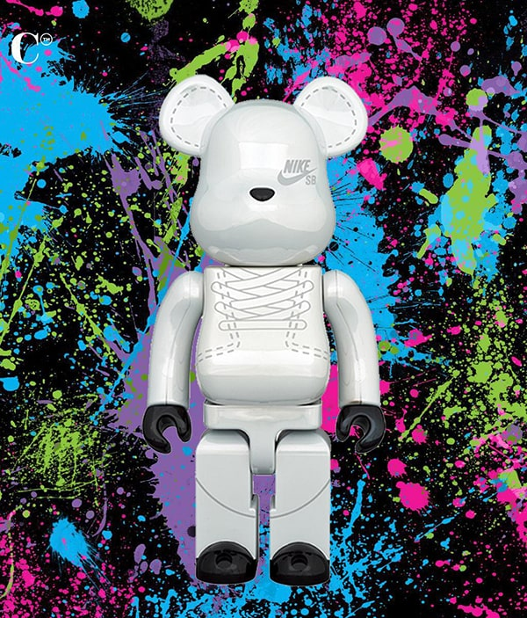
Purpose:
The purpose of the Bearbrick website is to provide a place for users to easily shop for Bearbrick products. The website can also provide detailed information about Bearbrick products, helping users better understand the brand.

Slide 7

Functionality:
Sign up - Sign in
Product categories
Product search
Cart - Checkout
Online payment

Slide 8
Purchase process:
Customer
Enter information
Store confirmation
Access the website, view promotional information, and search for products
Customers can make purchases by either logging in or buying directly, entering complete information, and confirming the order
Staff checks and confirms the order and delivers it to the customer
1
2
3
4
5
1
Select product
Place an order
Select the desired product, confirm and add it to the cart
Confirm the order, receive order notification via email

Slide 9
02
The goal of the website

Slide 10






The goal of the website
Create a beautiful, user-friendly, and attractive website interface to attract customers
Provide complete information about the products
Provide online ordering and secure payment features that are convenient for customers
Build a system for managing orders and operating the website
Create a good shopping experience for customers, from searching and ordering to shipping and post-sales support

Slide 11
03
Product demo

Slide 12
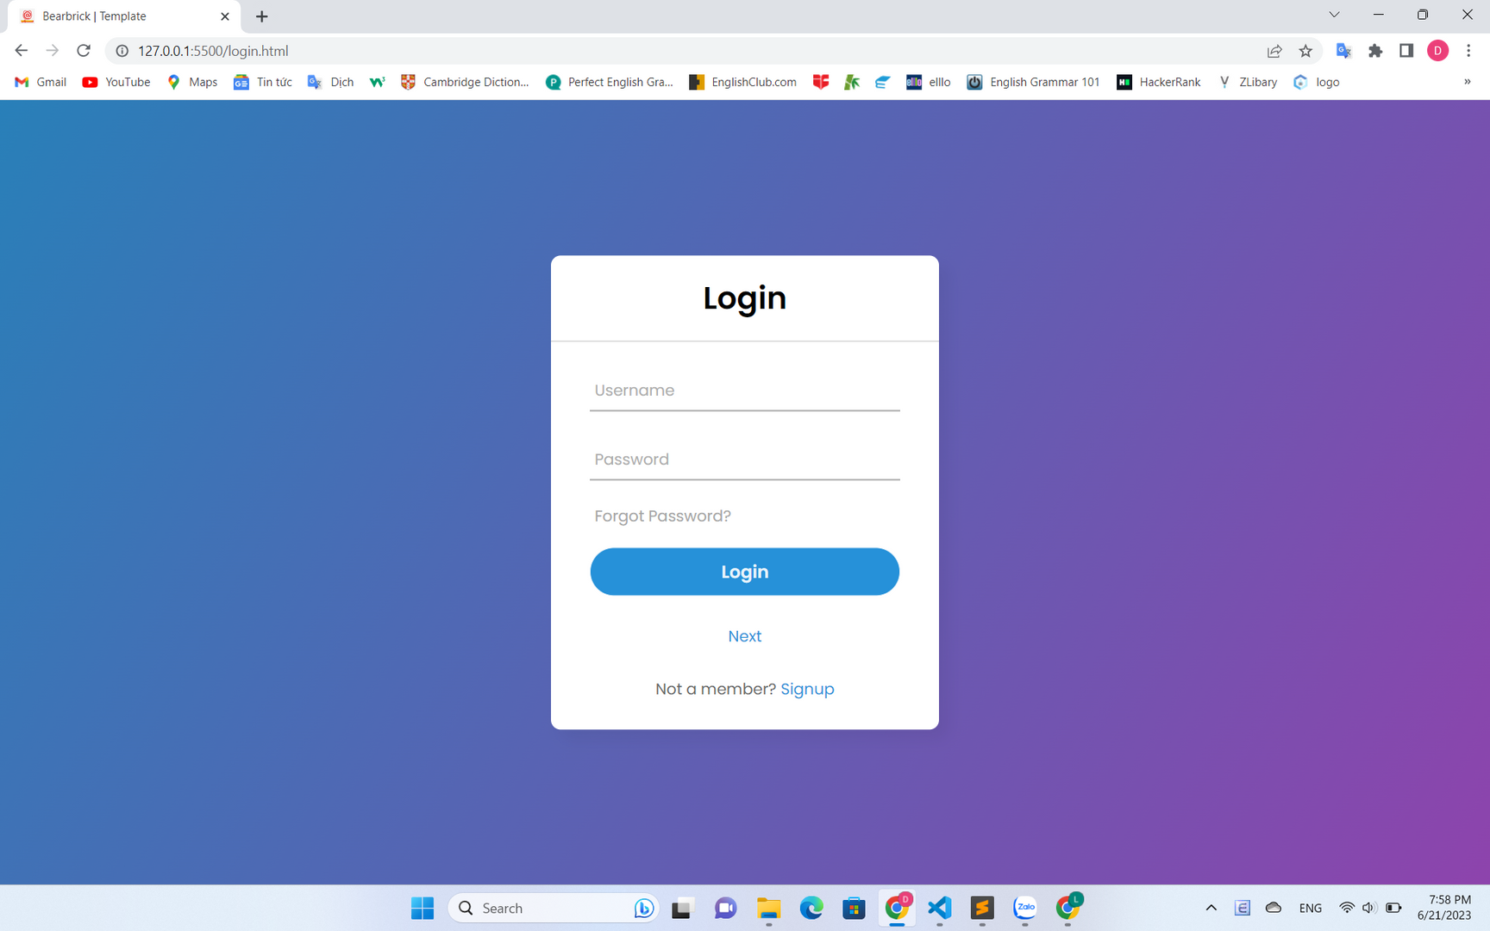
Product demo:
Image 1. Login

Slide 13
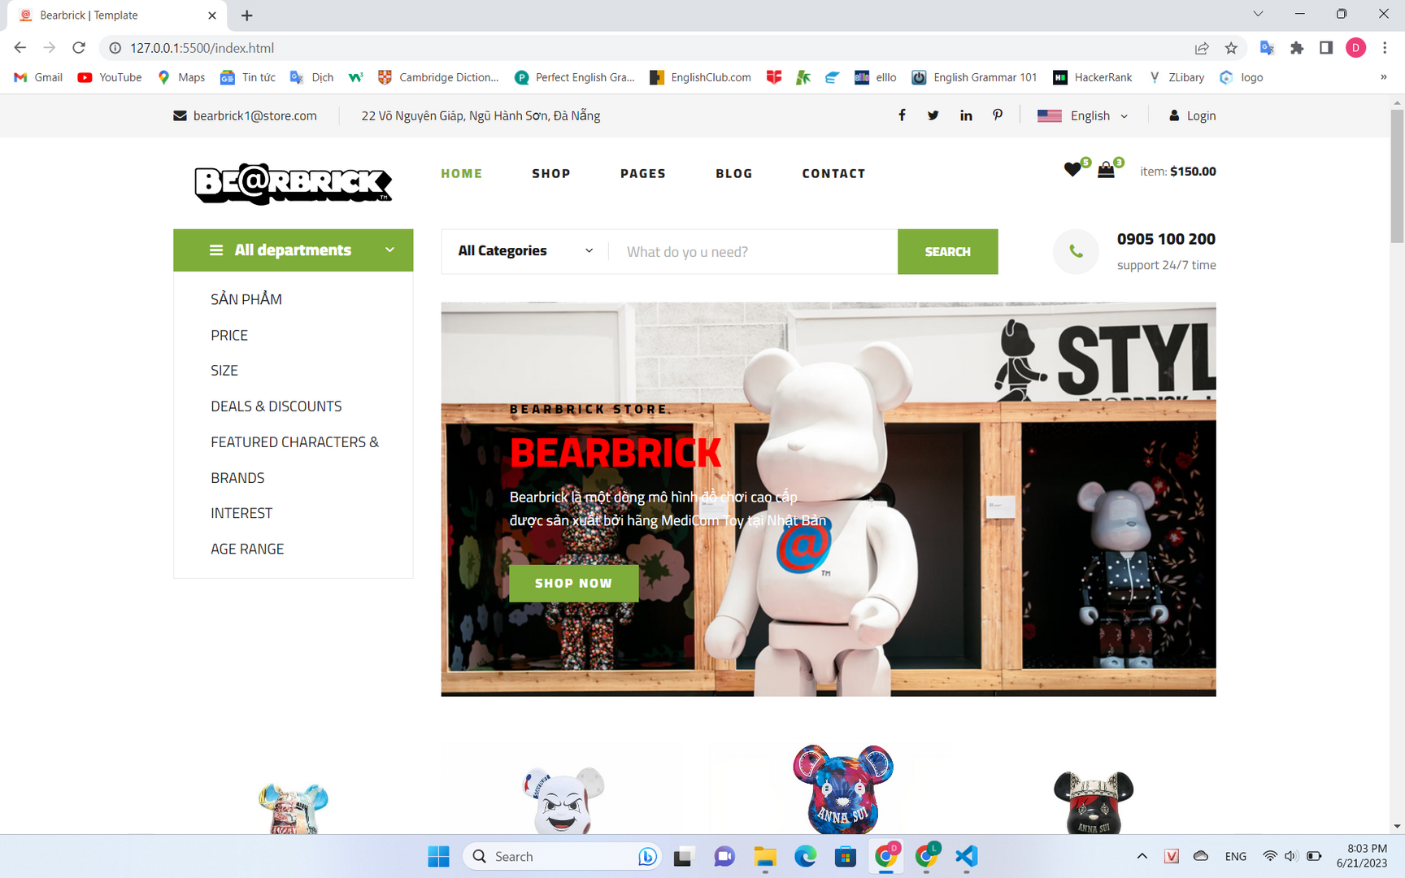
Image 2. Homepage

Slide 14
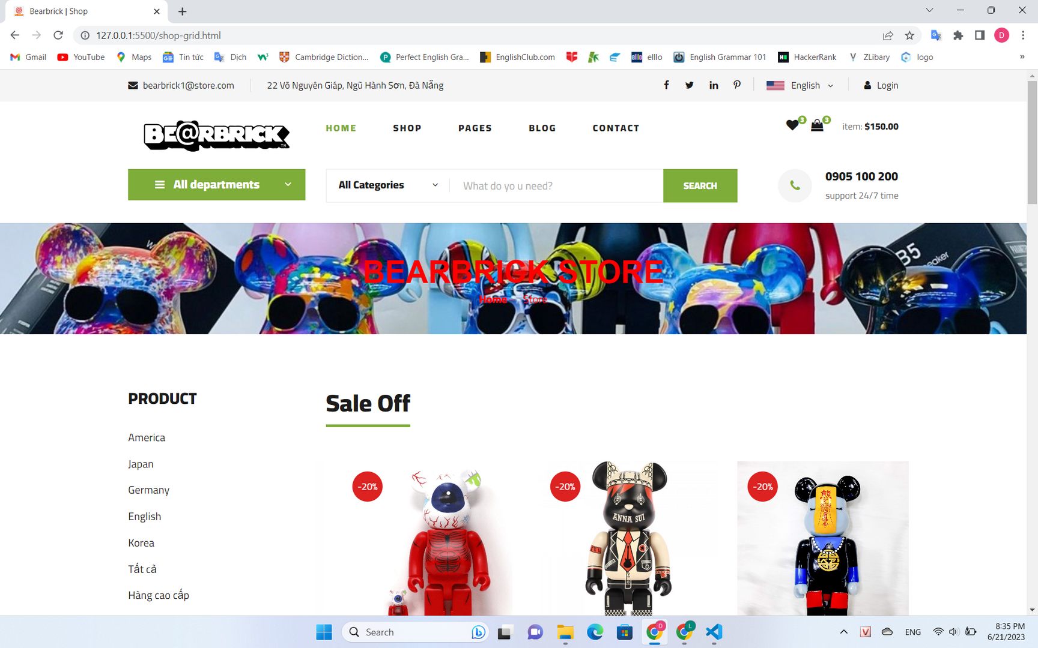
Image 3. Shop

Slide 15
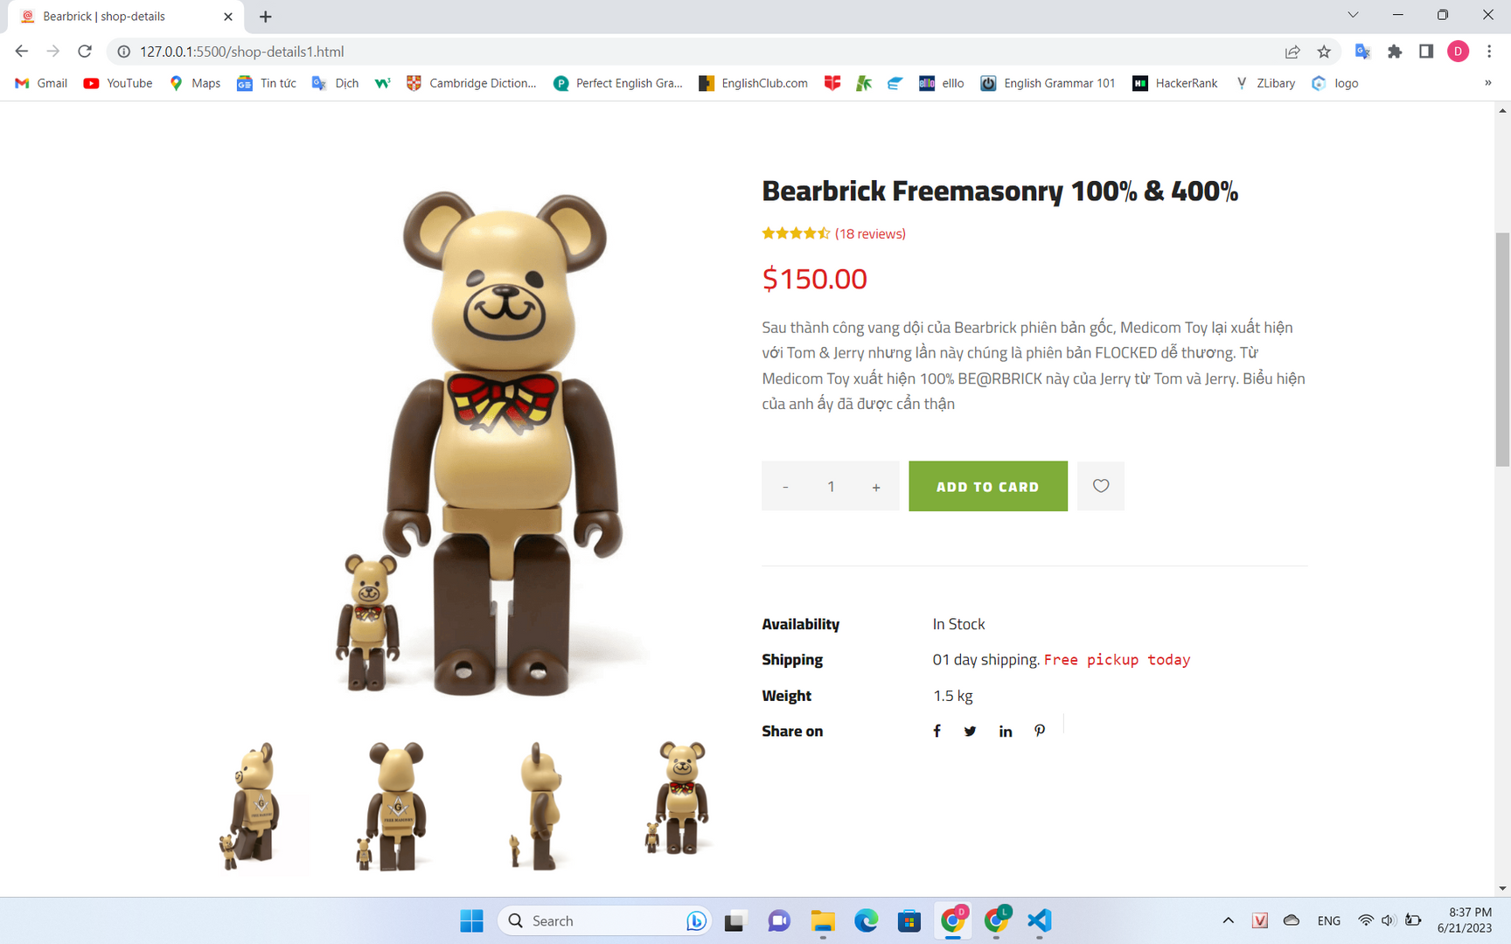
Image 4. View products

Slide 16
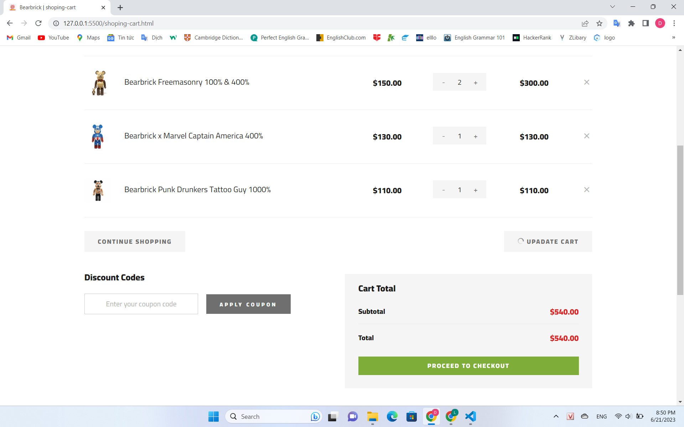
Image 5. Shopping cart

Slide 17
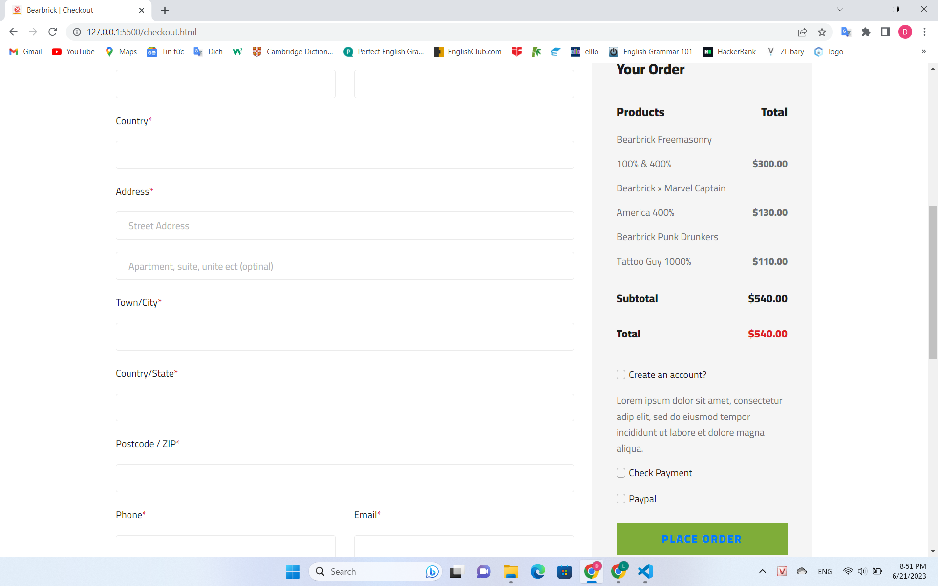
Image 6. Check out

Slide 18
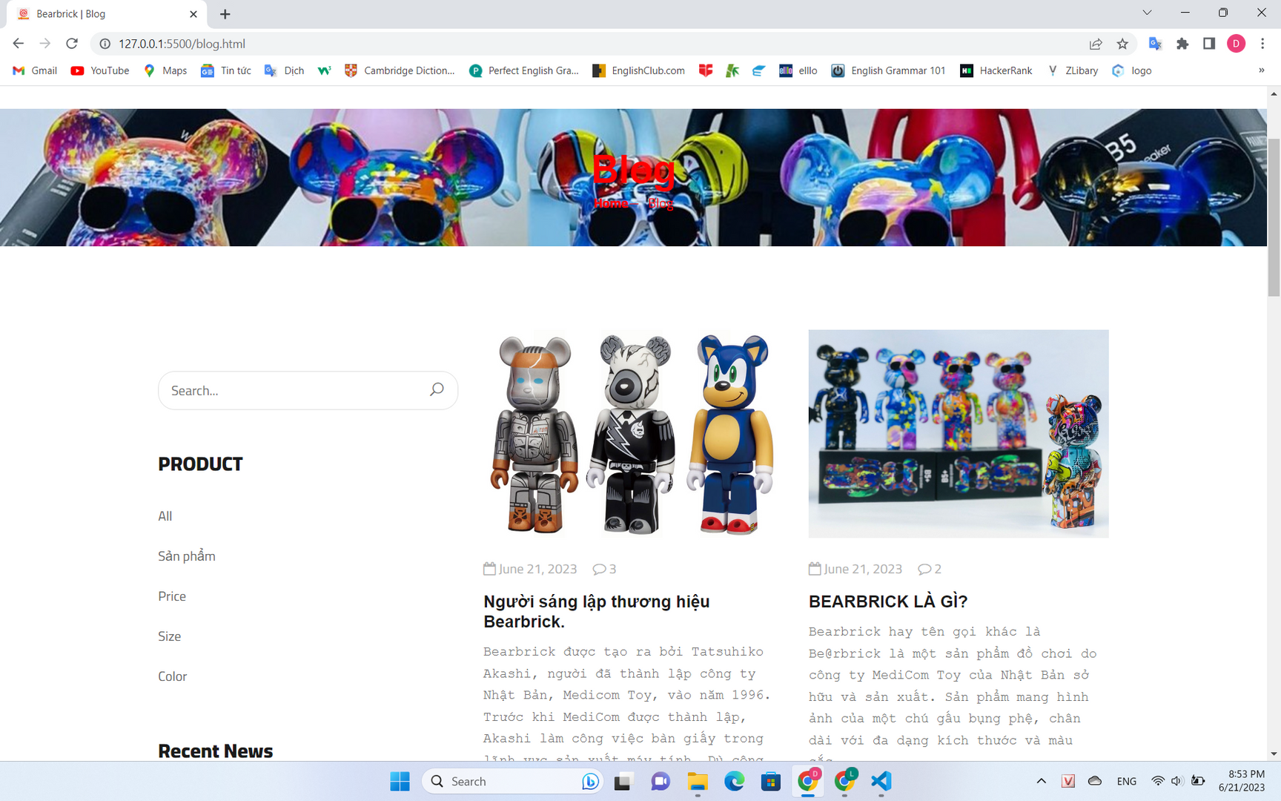
Image 7. Blog

Slide 19
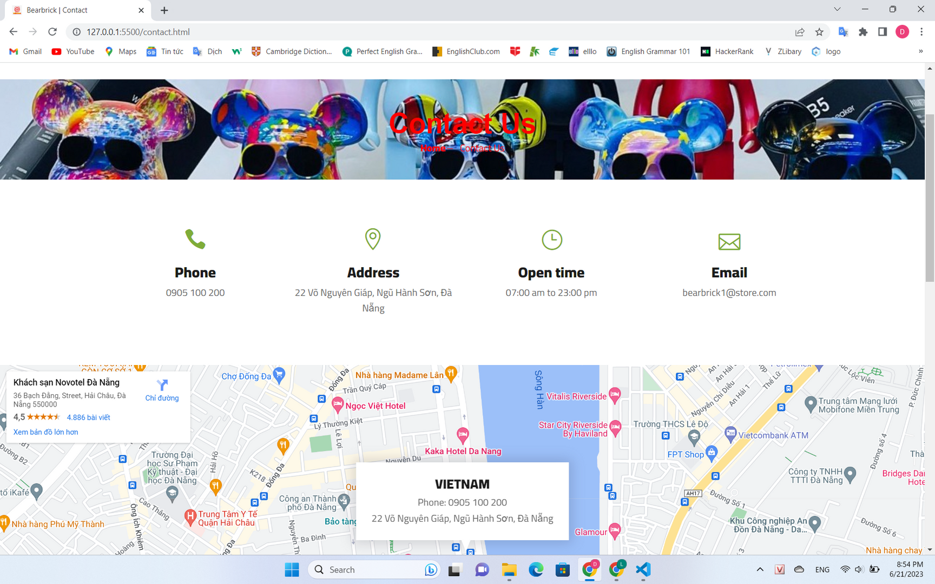
Image 8. Contact us

Slide 20
04
Conclusion and development direction

Slide 21
Limitations:
01
Competition with other online shopping websites
Security issues
02
Potential customers who are not yet familiar with Bearbrick products
03
Market impact
04

Slide 22
Enhance user experience
Boost advertising and customer outreach
Development direction
Expand product range
Create a safe and trustworthy trading environment
Collaborate with shipping and other sales partners

Slide 23





THANK YOU

